Slide 1
GENERATING MULTIPLE OBJECTS AT SPATIALLY DISTINCT LOCATIONS
image caption , bounding boxes and the respective labels of the desired objects
fine-grained control of the image layout
1. control the location of arbitrarily many objects within an image by adding an object pathway to both the generator and discriminator
2. global pathway focus on global image characteristics and the image background
Notes:
Made by Li Jia
确实可以对图像生成过程进行额外的控制通过在GAN中引入对象路径。更好地控制GAN中的图像生成过程
能够控制身份和基于边界框在给定图像内定位多个对象（大小/位置），从而便于实现生成更复杂的场景。
在场景表示和对象表示之间允许我们控制身份，位置，和图像中任意多个对象的大小，只要对象不重叠太强。
it is possible to add our object pathway to pre-existing GAN models without having to change the overall model
architecture or training process.
global pathway
focus on global image statistics
object pathway
more fine-grained attention to detail of specific objects

Slide 2
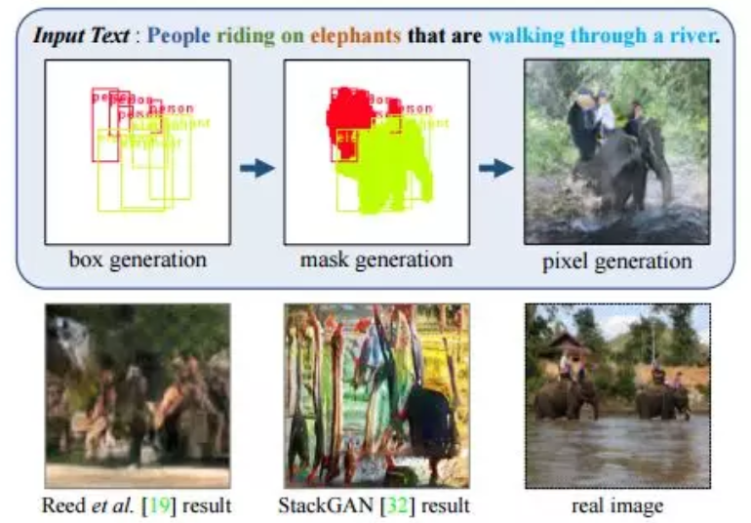
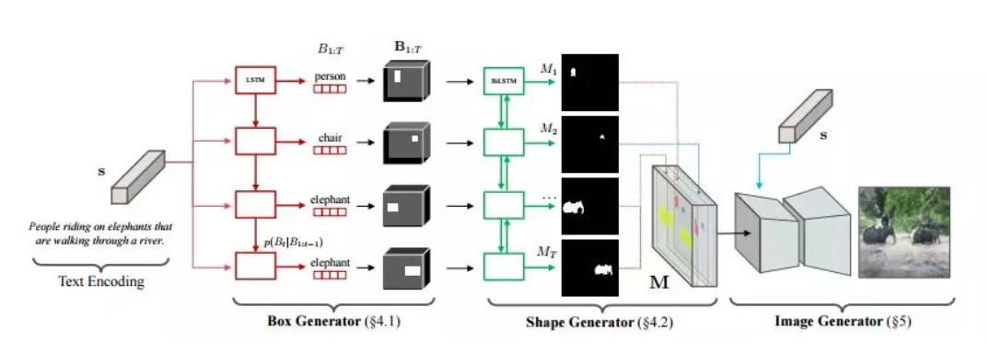
Inferring semantic layout for hierarchical text-to-image synthesis.
Notes:
Seunghoon Hong 2018
给定一个文本描述，我们的算法序列性地构造一个场景的语义结构，并生成一个基于推断布局和文本的图像。可以根据标注的颜色进行查看。

Slide 3
前人工作
implying complex preprocessing steps in which the scene layout is constructed.
使用的图像具有相对较低的可变性（例如鸟类）并且仅包含一个对象，通常位于图像的中心。
This work
object pathway->individual objects and learns relevant features 基于相关的对象标签和位置显式生成不同对象的特征，指定位置对单个对象进行建模。
global pathway ->global image characteristics and the image background 负责生成完整图像的总体布局
Contributions:
1) a GAN model that enables us to control the layout of a scene without the use of a scene layout.
2) object pathway ->gain control over the identity and location of arbitrarily many objects within a scene.
3) The discriminator judges not only if the image is realistic and aligned to the natural language description,
but also whether the specified objects are at the given locations and of the correct object category.
4) object pathway ->indeed learn relevant features for the different objects,
while the global pathway focuses on general image features and the background.
Notes:
have one object pathway that is applied several times across different labels labeli
and whose output feeds onto the corresponding coordinates on the empty canvas
similarly to the generator we only use one object pathway that is applied to multiple image locations, where the outputs are then added onto the empty canvas, summing up overlapping parts and keeping areas outside of the bounding boxes set to zero
非极大值抑制NMS

Slide 4
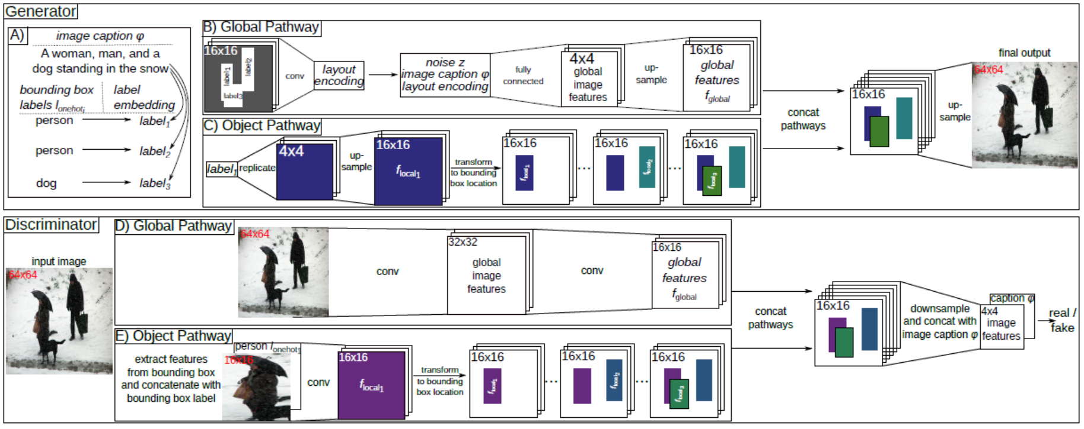
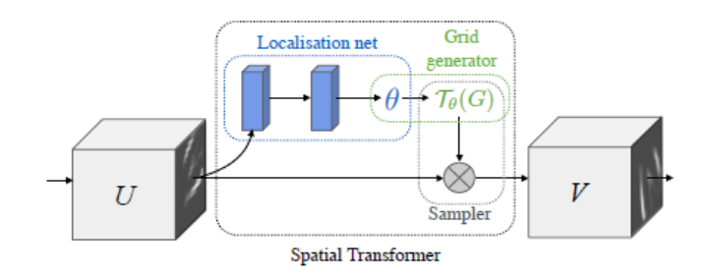
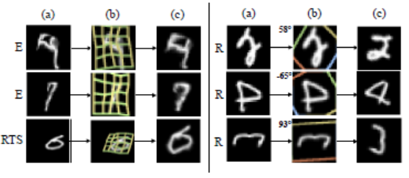
x是图像，c是该图像的条件信息（例如labeli，边界框bboxi或者是图像标题φ)
StackGAN (Zhang et al., 2018a) and AttnGAN (Xu et al., 2018b) frameworks
Notes:
conditioning augmentation for the image captions which helps improve the training process and the quality of the generated images
Spatial Transformer Network (STN) 2015
Here, we added the object pathways and the layout encoding at the beginning of both the first generator and the second generator and
used the object pathway in both discriminators.
文本到图像合成的架构
将我们的对象路径添加到预先存在的GAN模型，而无需更改整体模型结构或培训过程。添加对象路径为我们提供了更多的控制权
Label embedding将具有三个等级的输入数据减少为二维数据。

Slide 5
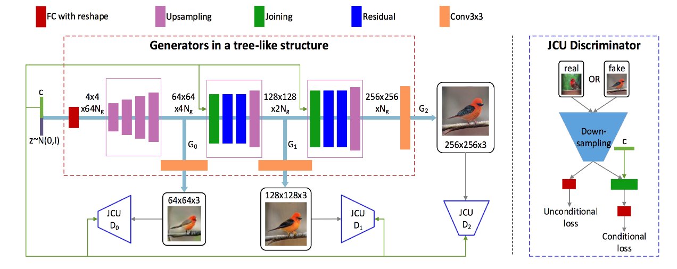
StackGAN-v2
Notes:
Stackgan++: Realistic image synthesis with stacked generative adversarial networks.
first, it learns a generator for images with a resolution of 64 64 px based on the image captions,
and second, it trains a second generator,
which uses the smaller images (64 64 px) from the first generator and the image caption as input to
generate images with a resolution of 256256 px.

Slide 6
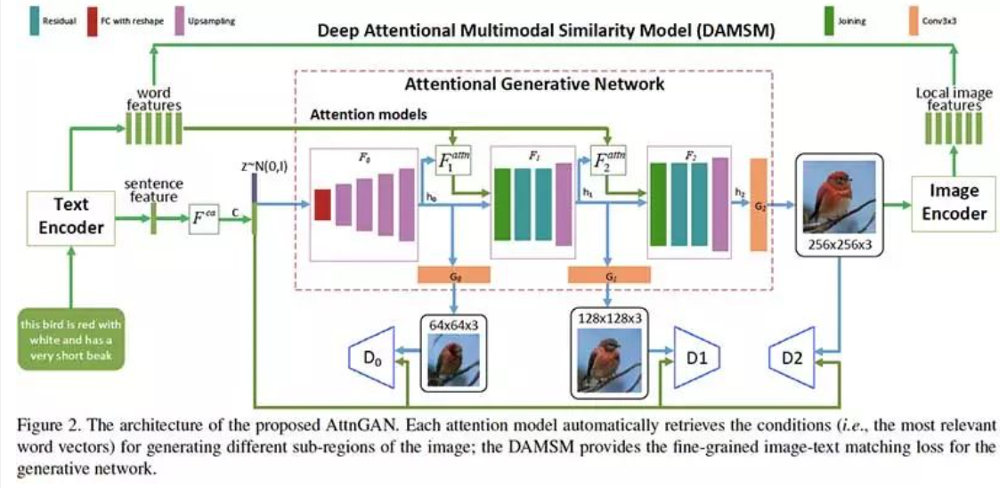
AttnGAN
Notes:
Attngan: Fine-grained text to image generation with attentional generative adversarial networks.
允许注意力驱动的多阶段细化，以实现细粒度粒度的文本到图像的生成。
通过多阶（例如，单词级和句子级）调节来实现细粒度的高质量图像生成。
因此，研究人员提出了一种体系结构，其中生成网络通过这些子区域最相关的单词来绘制图像。
AttnGAN只包含一个模型通过利用多个中间鉴别器对图像标题进行端到端训练。
AttnGAN实现了一种注意技术网络通过其关注图像中特定单词的特定图像区域,
并添加额外的损失，检查图像是否描述了标题内容
place objects similar to traffic lights throughout the whole image

Slide 7
AttnGAN
利用全局句子向量在第一阶段生成低分辨率图像
将区域图像矢量与对应的词语上下文矢量组合以在周围子区域中生成新的图像特征
而深度Attentional多模态相似度模型（DAMSM），用于计算生成的图像和文本描述之间的相似性，为训练生成器提供额外的细粒度图文匹配损失。

Slide 8
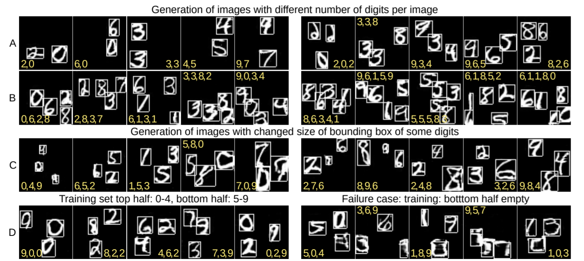
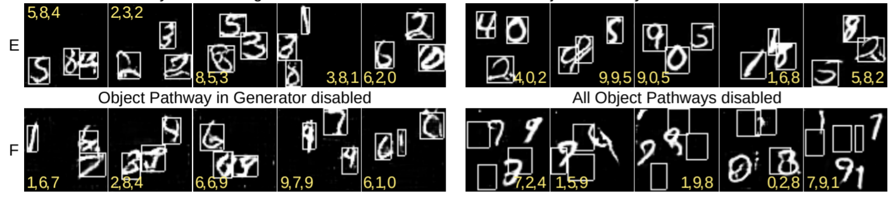
EVALUATION AND ANALYSIS 数据集：Multi-MNIST数据集，CLEVR数据集和MS-COCO数据集。
ablation studies
layout encoding
object pathways
Notes:
创建了50,000张分辨率为64×64像素的图像，其中包含三个正常大小的MNIST
黑色背景上非重叠位置的数字
控制数字标识，生成的数字大小和生成的数量每张图片的数字。
F右失去控制 无论是图像位置还是身份
d both the layout encoding, for a better integration of the global and object pathways,
and the object pathways in both the discriminator and the generator, for optimal results.

Slide 9
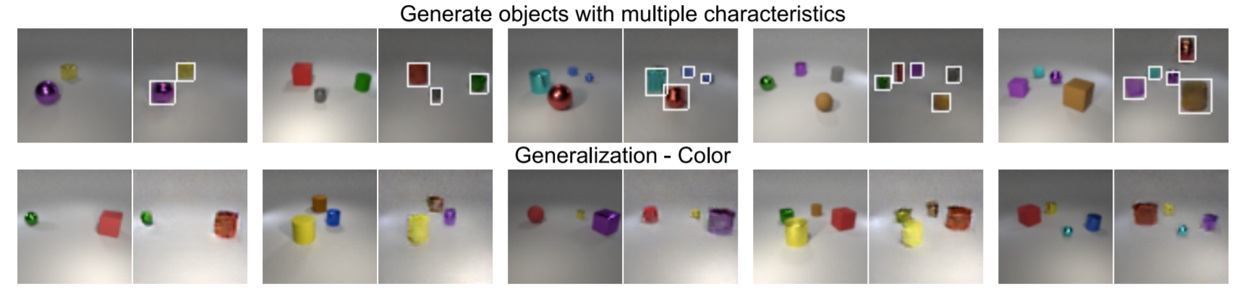
CLEVR
Notes:
评估我们的泛化能力跨越不同对象特征的对象路径。
给定边界框的标签对象的形状和颜色（都编码为一个热编码，然后连接），而对象大小是通过边界框的高度和宽度指定的。
模型可以控制对象特征（通过标签提供）和对象位置（通过边界框提供）并且可以推广到新的对象位置，
新的数量每个图像的对象，以及合理边界内的新对象特征组合。

Slide 10
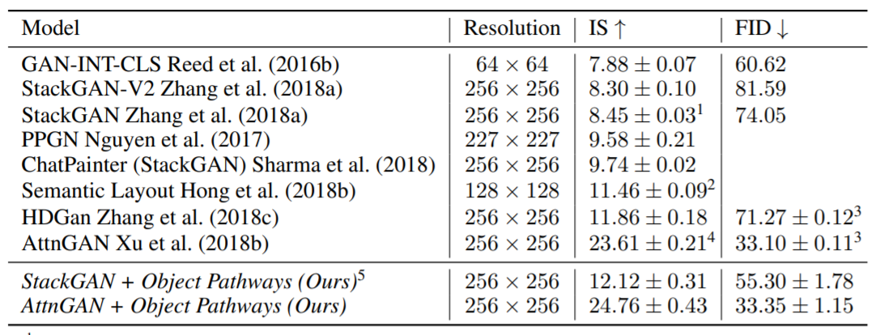
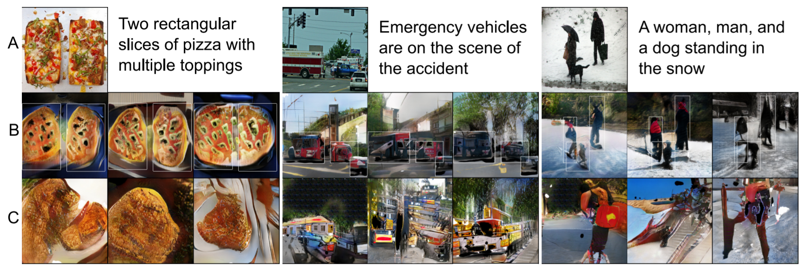
CoCo
StackGAN
Notes:
trained the model three times from scratch and randomly sampled 3 times 30,000 image captions from the test set for each model.
在train时刻，我们使用了边界框和图像中三个最大对象的对象标签
生成包含多个对象的图像，并检查是否边界框可以控制对象放置。
在StackGAN中，added the object pathways and the layout encoding at the beginning of both the first generator and the second generator
and used the object pathway in both discriminators.
StackGAN架构的其他部分和所有超参数保持与MS-COCO数据集的原始训练过程相同。

Slide 11
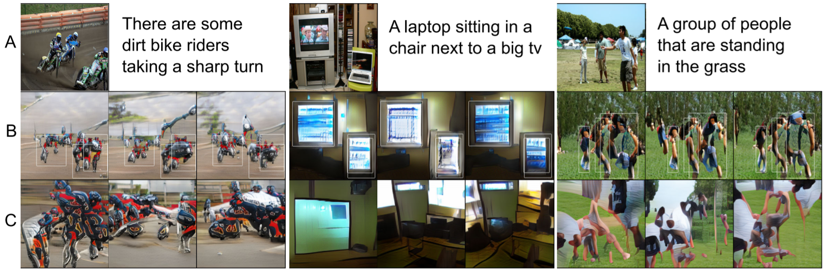
CoCo
AttnGAN
Notes:
current state-of-the-art model on the MS-COCO data set
AttnGAN只包含一个模型通过利用多个中间鉴别器对图像标题进行端到端训练。
AttnGAN实现了一种注意技术网络通过其关注图像中特定单词的特定图像区域
标题并添加额外的损失，检查图像是否描述了内容
place objects similar to traffic lights throughout the whole image
AttnGAN + OP在所需的位置生成所需的对象

Slide 12
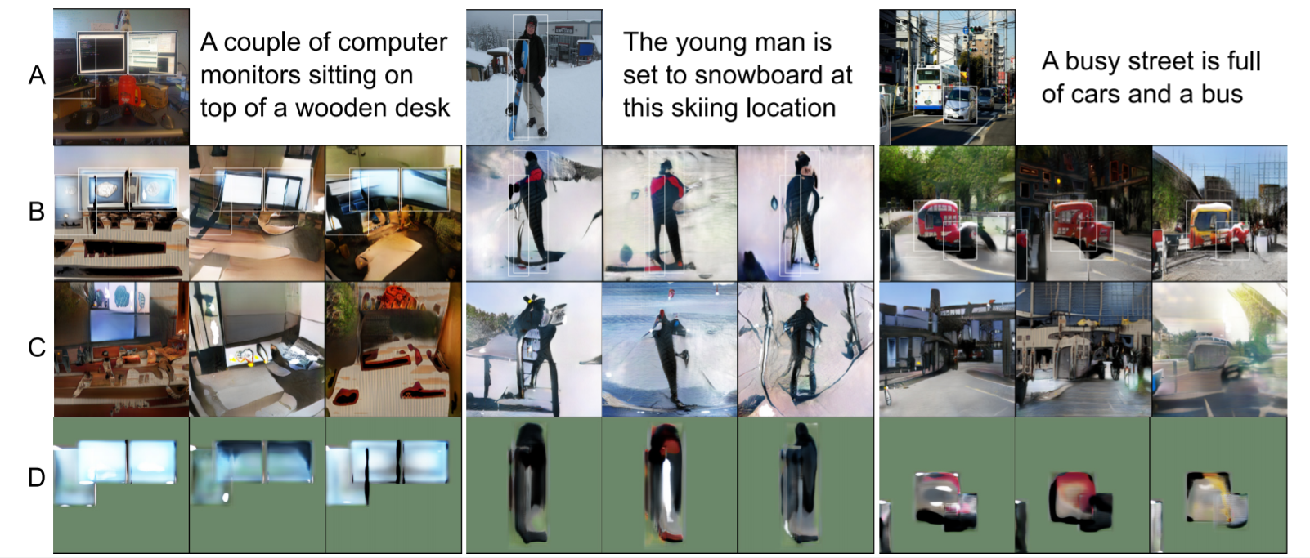
CoCo
Notes:
全局路径确实建模整体图像特征，而对象路径则侧重于特定的单个对象。
消融研究
global pathway generates features for the general image layout and background but does not provide sufficient details for individual objects.
focuses entirely on the individual objects and generates features specifically for a given object at a given location.

Slide 13
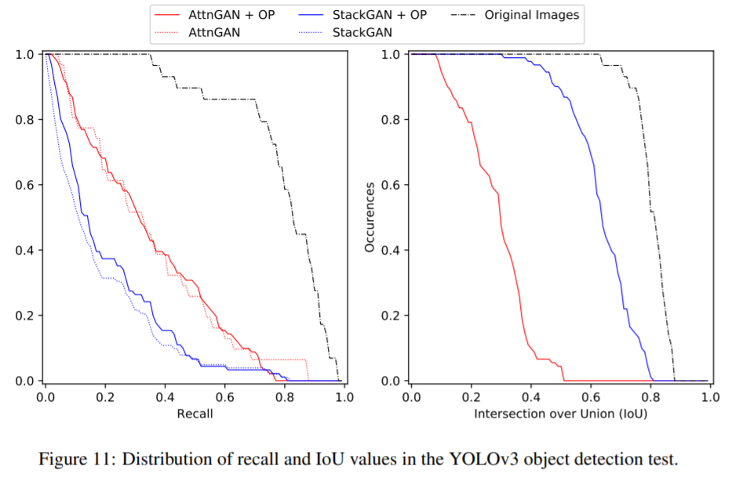
OBJECT DETECTION ON MS-COCO IMAGES
Notes:
目的：measure how often an object detection framework, which was trained on MS-COSO as well,
can detect a specified object at a specified location？
The StackGAN generates objects at the given bounding box,
AttnGAN
tends to place 显著object features throughout the image, which leads to an even higher detection
rate by the YOLOv3 network, but a smaller average IoU

Slide 14
DISCUSSION
优点：
1.对象路径是可以添加的扩展常见的GAN架构对原始架构没有太大的改变
2.可以和图像布局结合进行更细粒度的控制
3.可以带来更好的图像质量。
Weakness：
1. individual object are too small to warrant a bounding box
2.模型不会自动生成边界框和标签，它们必须在测试时提供
3. bounding boxes that overlap too much lead to sub-optimal objects at that location
Notes:
确实可以对图像生成过程进行额外的控制通过在GAN中引入对象路径。
object pathway provides us with more control over theimage generation process and can,
in some cases, increase the quality of the generated images as measured via the IS or FID.

